Slide 1
Bank Loan Case Study
Here is where this template begins

Slide 2
TABLE OF CONTENTS
TASK
PROJECT DESCRIPTION
TOOLS USED
INSIGHTS AND RESULT
APPROACH
CONCLUSION
DRIVE LINK

Slide 3
PROJECT DESCRIPTION
With this case study, we hope to demonstrate how to use EDA in a practical corporate setting. In addition to using the EDA module's approaches in this case study, you will get a fundamental grasp of risk analytics in banking and financial services and discover how data is utilized to reduce the risk of losing money when lending to consumers.
Business insight: Lending to individuals is challenging for loan-providing businesses. Because their credit history is weak or nonexistent. Because of this, some customers take advantage of it by defaulting. Imagine you work for a consumer finance firm that specialized in providing urban consumers with several forms of loans. To assess the patterns found in the data, you must utilize EDA. This will prevent applications that can repay the loan from being denied.
The business must choose a loan after receiving a loan application. Depending on the applicant's profile, approval. The bank's choice is accompanied with two different categories of risks:• If the applicant is likely to repay the loan, denying the loan results in a loss of business for the firm; however, granting the loan if the applicant is not likely to return the loan, i.e., if he or she is likely to default, may result in a financial loss for the company.

Slide 4
TASK
1.Identify missing data and deal with it. Appropriately: Identify the missing data in the dataset and decide on an appropriate method to deal with it
2. Identify Outliers in the Dataset: Detect and identify outliers in the dataset
3. Analyze Data Imbalance: Determine if there is a data imbalance in the loan application dataset and calculate the ratio of the data imbalance.
4.Perform Univariate, Segmented Univariate, and Bivariate Analysis: Perform univariate analysis to understand the distribution of individual variables, segmented univariate analysis to compare variables distributions for different scenarios, and bivariate analysis to explore relationships between variables and the target variable
5. Identify the Top Correlations for Different Scenarios: Segment the dataset.

Slide 5



TOOLS USED
Jupyter Notebook: USING FOR CLEANING AND VISUALIZATION
EXCEL: FOR VISUALIZATION
MICROSOFT POWERPOINT (VERSION: MICROSOFT 2016): FOR
CREATING THE REPORT

Slide 6
APPROACH
1. Data Acquisition and Familiarization
2. Data Cleaning With Python
3. Data Analysis in Python
4. Visualization in Python
5. Project Report

Slide 7
APPROACH
• Data collection and familiarization: The process started with the download of the source's datasets. After that, a complete comprehension of the dataset's structure, variables, and underlying information was attained.
• Data cleansing using Python: The datasets were cleaned and preprocessed using the Python programming language. Among the tasks was processing missing data.
• Data analysis in Python: After the data cleaning procedure was finished, a preliminary data analysis in Python was carried out. Exploratory data analysis (EDA) methods were used to glean preliminary conclusions and spot any interesting patterns or trends
.• Python and Excel visualization: The cleansed datasets were downloaded next Interactive and aesthetically attractive graphs and visualizations were made using excel and python. To properly depict data and enable meaningful investigation, many chart formats were used.

Slide 8
INSIGHT AND RESULT

Slide 9
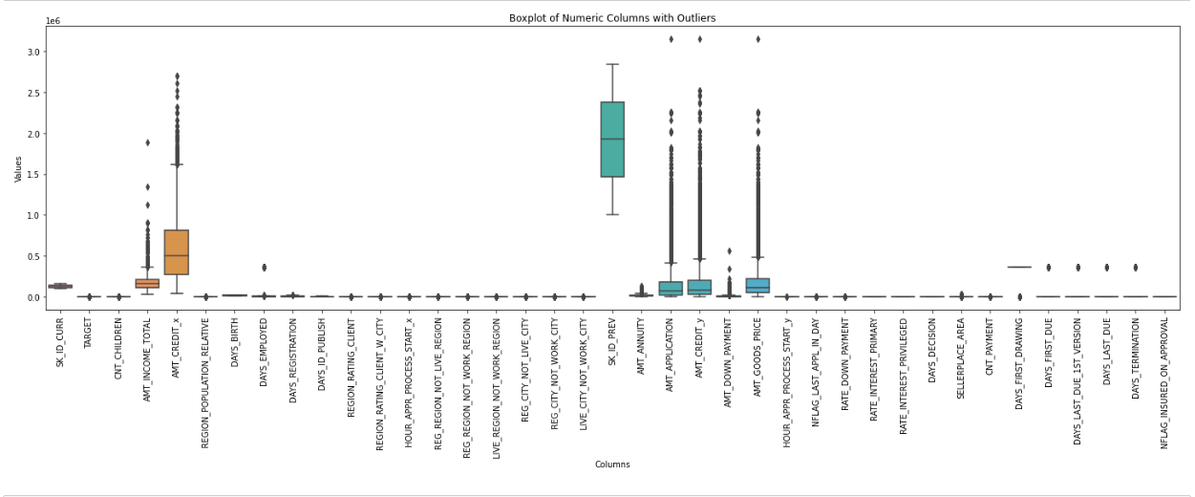
Identify Outliers in the Dataset
This is the outliers of the data set column wise

Slide 10
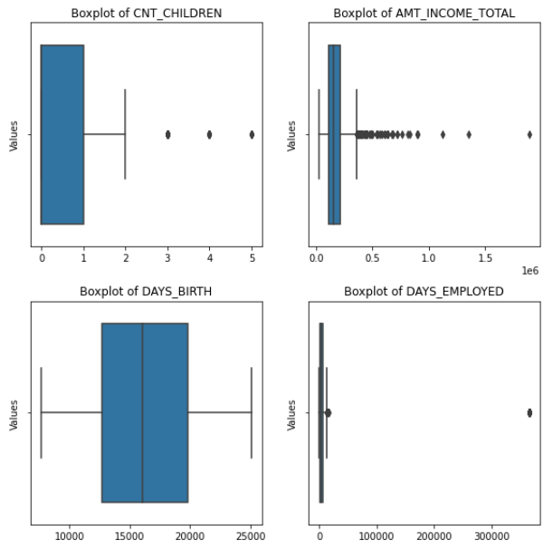
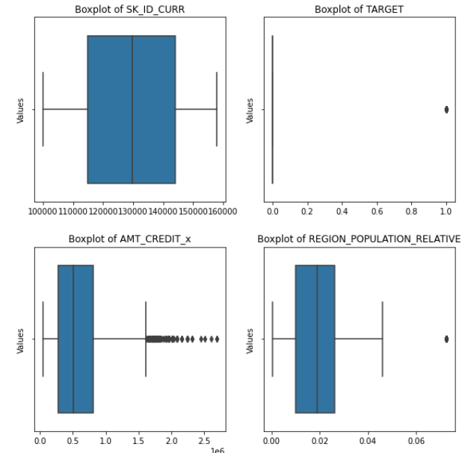
Identify Outliers in the Dataset
This is the outliers of the data set column wise and for calculating outliers you need to perform some important steps. Z-Score: Calculate the Z-score for each data point. Data points with Z-scores above a certain threshold (e.g., 2 or 3) are considered outliers.
IQR (Interquartile Range): Calculate the IQR, which is the difference between the 75th percentile (Q3) and the 25th percentile (Q1). Data points below Q1 - 1.5 * IQR or above Q3 + 1.5 * IQR are considered outliers.

Slide 11
Identify Outliers in the Dataset
The existence of people with much greater earnings than the majority is shown by outliers in income totals. These anomalies can be high-earning professions or people with sizable investments. A better understanding of this distribution can be used to assess borrower risk and customize financial solutions

Slide 12
Identify Outliers in the Dataset
Outliers in the number of days worked indicate that some people have worked for a disproportionately long duration. This can suggest steady work and a lesser danger of losing your job. Informed risk assessments and customized loan packages for long-tenured employees are made possible by recognizing these outliers.

Slide 13
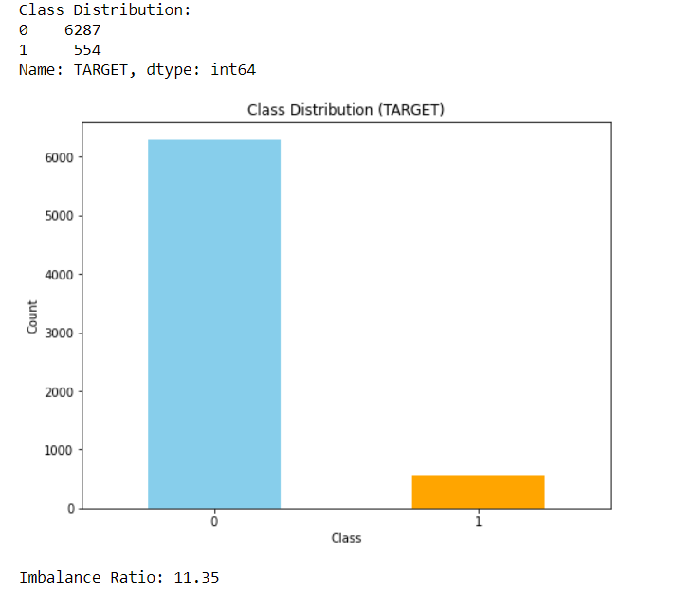
Analyse Data Imbalance
The dataset reveals a severe class imbalance, with a ratio between non-defaulters and defaulters of around 1:11.
A skewed distribution like this suggests that there aren't as many default clients as there are non-default clients.
1: default
0:non default

Slide 14
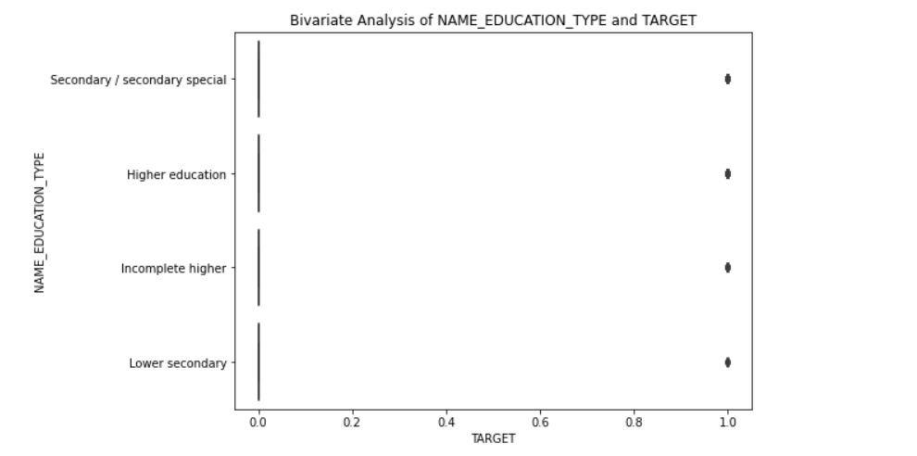
Perform Univariate, Segmented Univariate, and Bivariate Analysis
Understanding the relationship between the target variable (TARGET) in your dataset and the education level (NAME_EDUCATION_TYPE) is the aim of this investigation. Usually binary, the target variable TARGET can be divided into two classes, such as "0" (no default) and "1" (default).
In conclusion, this boxplot-based bivariate analysis is a crucial step in comprehending the connections between variables and may be used as the foundation for additional investigation and modelling throughout the data analysis process.

Slide 15
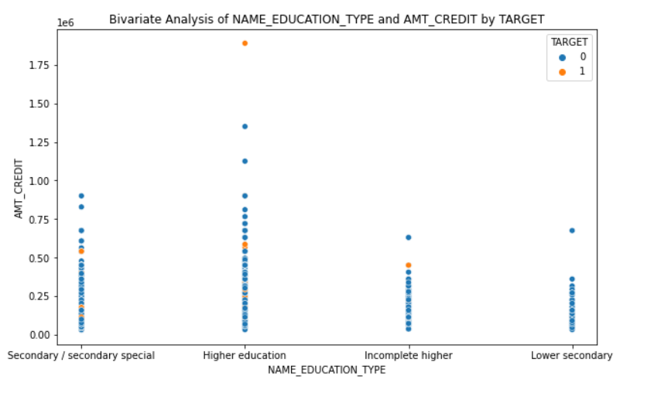
Perform Univariate, Segmented Univariate, and Bivariate Analysis
Certainly! A useful tool for performing bivariate analysis is the given syntax for creating a scatterplot (sns.scatterplot) of NAME_EDUCATION_TYPE versus AMT_INCOME_TOTAL, with data points color-coded by TARGET. What you can learn from this analysis is as follows:
This analysis's objective is to investigate the connections among your dataset's loan default status (TARGET), yearly income (AMT_INCOME_TOTAL), and educational attainment (NAME_EDUCATION_TYPE). The binary target variable, TARGET, normally has two classes: "0" (no default), and "1" (default).

Slide 16
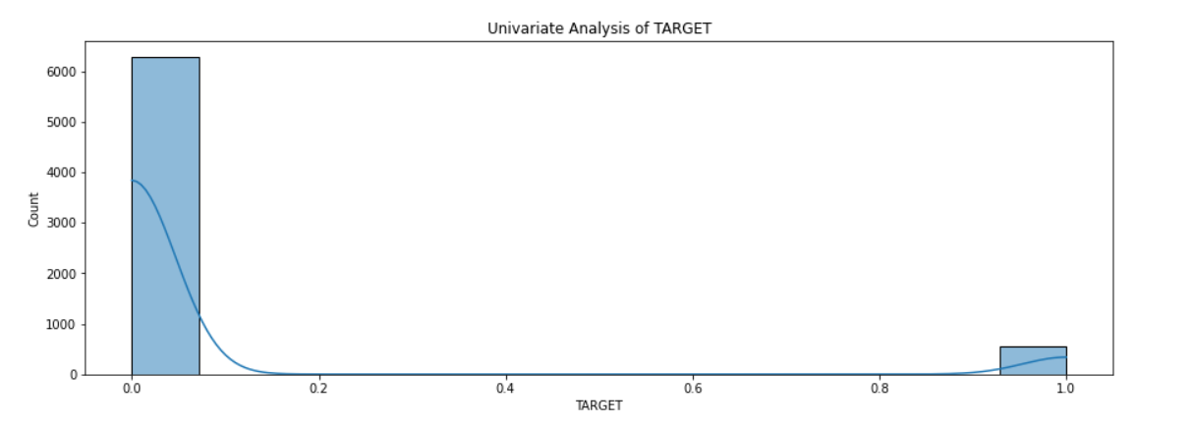
Perform Univariate, Segmented Univariate, and Bivariate Analysis
Univariate analysis allows you to examine the distribution of the "TARGET" variable. You can calculate and visualize summary statistics like mean, median, mode, standard deviation, minimum, and maximum values. These statistics provide insights into the central tendency and spread of the target variable.
In a binary classification task like the prediction of loan default, univariate analysis aids in the identification of class imbalances. You may determine the proportion or percentage of each class by counting the occurrences of each class (for example, "0" for no default and "1" for default).

Slide 17
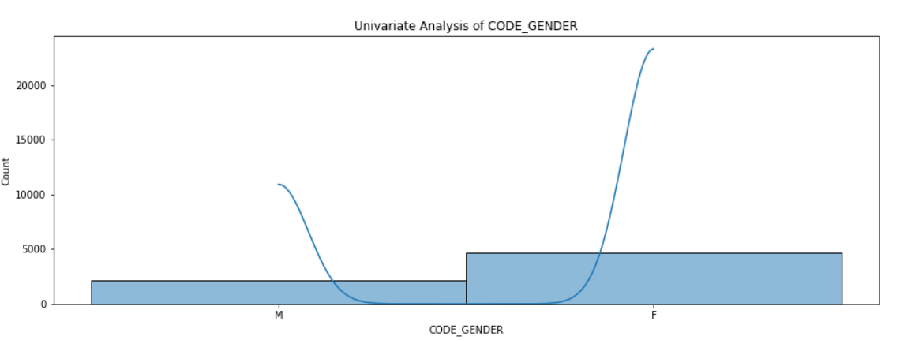
Perform Univariate, Segmented Univariate, and Bivariate Analysis
Gender Distribution: Univariate analysis enables you to look at how gender categories are distributed throughout the dataset. The number or percentage of each gender group (for example, "M" for male and "F" for female) can be calculated and visualized.
The distribution of gender categories can be represented graphically using bar plots or pie charts. It is simple to comprehend how the dataset is split up by gender thanks to these visualizations.

Slide 18
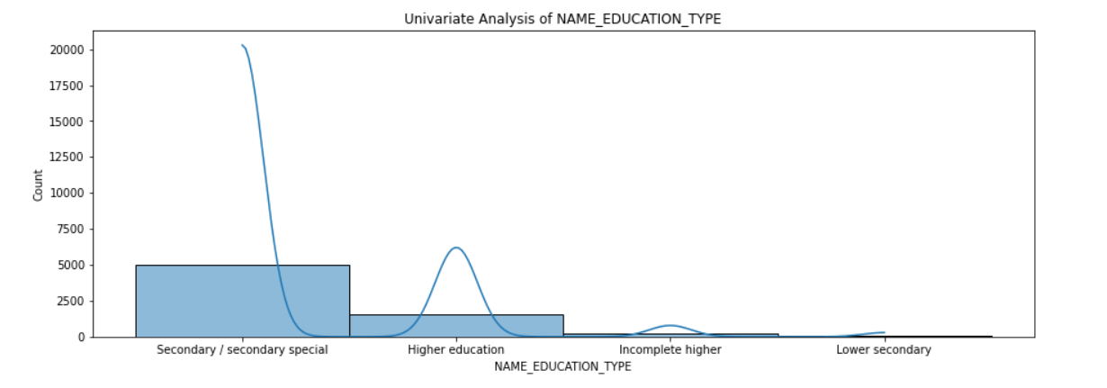
Perform Univariate, Segmented Univariate, and Bivariate Analysis
The distribution of education levels or categories within the dataset may be examined using a univariate analysis. The number or percentage of each sort of education, such as "Secondary / Secondary Special," "Higher Education," "Incomplete Higher," etc., may be calculated and visualized.
For the purpose of representing the distribution of educational categories graphically, bar plots or pie charts can be made. It is simple to comprehend the dataset's educational makeup thanks to these visualizations.

Slide 19
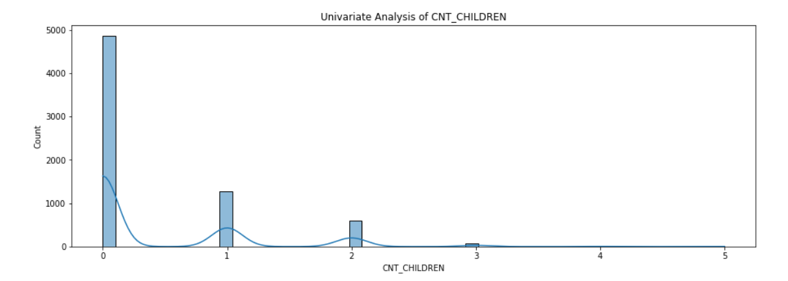
Perform Univariate, Segmented Univariate, and Bivariate Analysis
The "CNT_CHILDREN" variable's univariate analysis sheds light on the distribution and features of the children's number among the dataset's observations. The results of the "CNT_CHILDREN" variable's univariate analysis are as follows:
Distribution of Number of Children: Using a single variable analysis, you can look at how many children are present in the dataset. The proportion of people with different numbers of children—such as 0, 1, 2, 3, etc.—can be calculated and visualized.

Slide 20
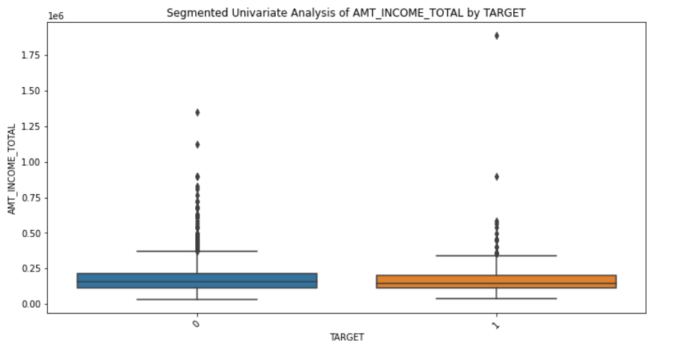
Perform Univariate, Segmented Univariate, and Bivariate Analysis
segmented univariate analysis focuses on examining how the "AMT_INCOME_TOTAL" variable is distributed throughout several segments identified by the "TARGET" variable. The "TARGET" variable in this setting probably stands for binary outcomes like loan default (1) and non-default (0).
The "AMT_INCOME_TOTAL" variable inside these segments, according to this segmented univariate analysis, is as follows:
Comparing Income Distribution: Using the boxplots, you can contrast the distribution of yearly income ("AMT_INCOME_TOTAL") of people who fit into two groups: those who defaulted on loans (TARGET = 1) and those who did not (TARGET = 0).

Slide 21
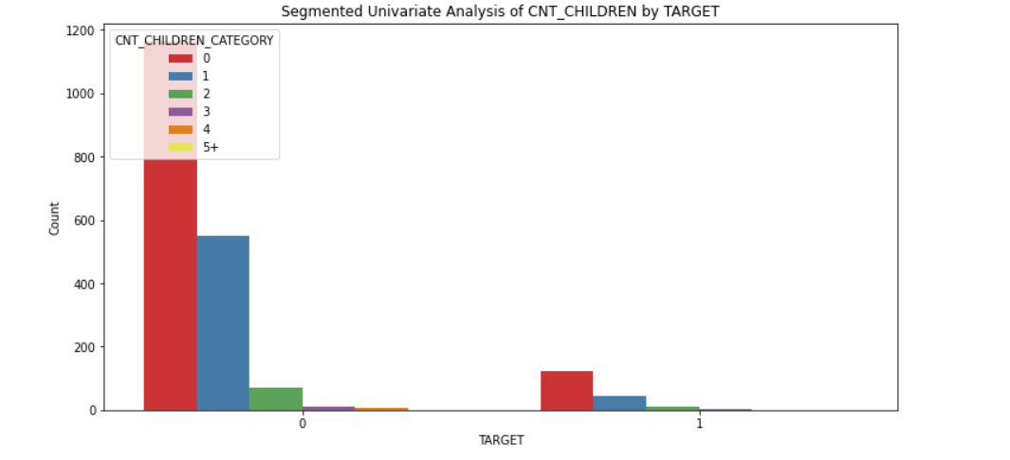
Perform Univariate, Segmented Univariate, and Bivariate Analysis
The "CNT_CHILDREN" variable has been changed into "CNT_CHILDREN_CATEGORY" and categorical bins have been established for it. Then, using a count plot with the "hue" argument, we make a stacked bar chart with each color denoting a distinct category of "CNT_CHILDREN." You can see in this graph how many kids are distributed throughout the segments determined by the "TARGET" variable.
To comprehend how the count of loan applicants with various numbers of children ('CNT_CHILDREN') changes between those who defaulted ('TARGET=1') and those who didn't ('TARGET=0'), develops a segmented univariate analysis in the form of a stacked bar chart.

Slide 22
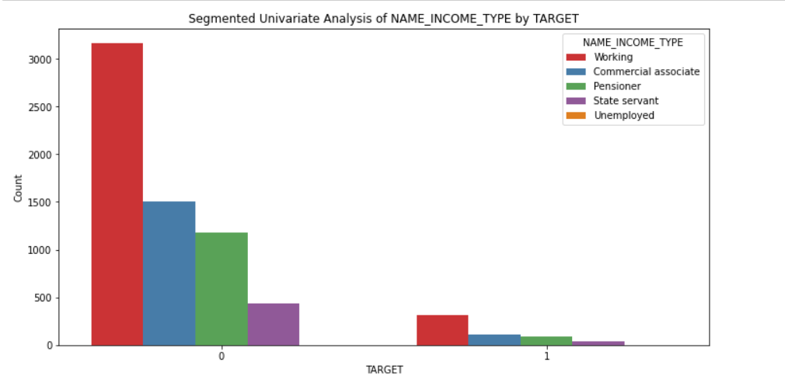
Perform Univariate, Segmented Univariate, and Bivariate Analysis
The link between the 'NAME_INCOME_TYPE' variable and the 'TARGET' variable, which denotes whether a loan applicant failed on a loan ('TARGET=1') or did not ('TARGET=0'), is seen in the stacked bar chart above. Here is how to understand it:
The x-axis is labelled "TARGET," where "0" denotes applicants who did not fail on their loans and "1" denotes those who did.
We have the number of loan applications on the y-axis.
Different categories of 'NAME_INCOME_TYPE,' which stands for the sort of income source used by loan applicants, are piled on the bars. These categories cover several forms of income, such as employment, business partnerships, government employment, pensions, and others.

Slide 23
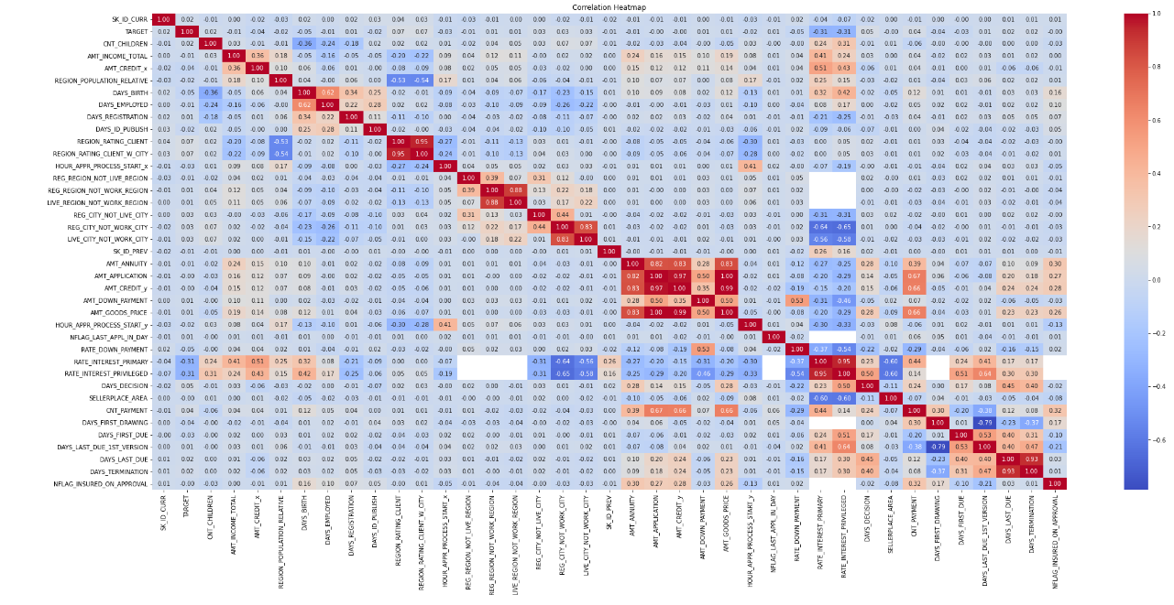
Identify Top Correlations for Different Scenarios
A statistical metric known as correlation quantifies how much two variables fluctuate in tandem. In other terms, it measures how strongly two variables are related or associated. You may learn how the values of one variable relate to those of another by using correlation. There are various ways to quantify correlation, but the Pearson correlation coefficient, which runs from -1 to 1, is the most used one:
A positive correlation (closer to 1) shows that the two variables tend to rise together as one rises.
When two variables are correlated negatively (closer to -1) it means that while one variable rises, the other tends to fall.
Little to no linear relationship between the variables is indicated by a correlation that is close to 0.

Slide 24
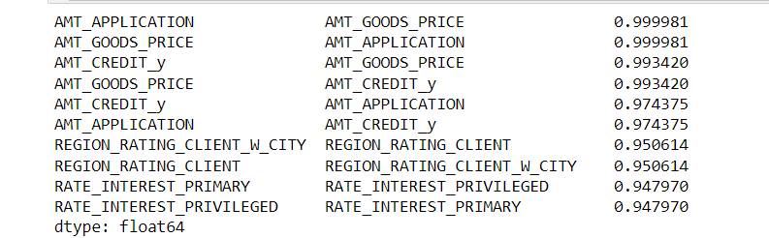
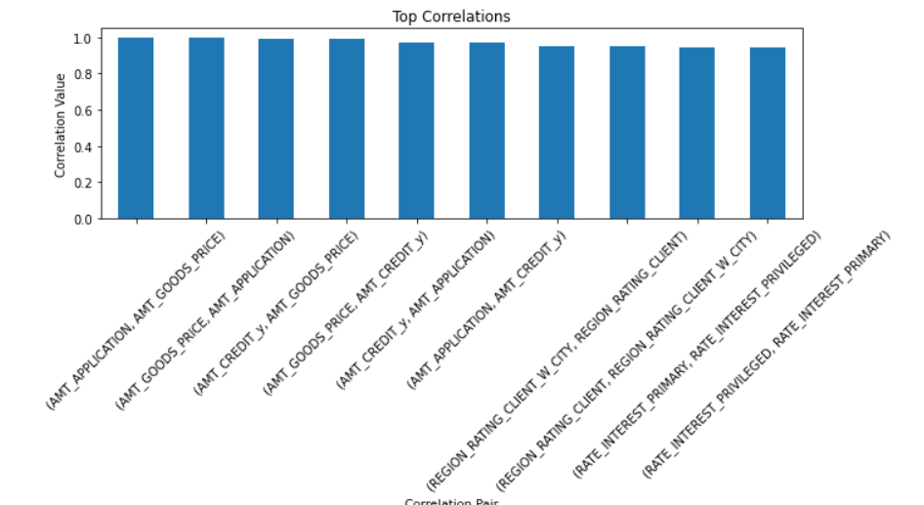
TOP 10 CORRELATION
The top 10 correlations in our dataset are shown . The examination of correlations in our dataset indicates some significant links between variables.
The variable AMT_APPLICATION and AMT_GOODS_PRICE had the strongest positive correlation, with a correlation value of 0.99, suggesting a very strong positive linear association.
We can better grasp the underlying patterns and dependencies thanks to our study of the top 10 correlations, which offers insightful information about the connections between the important variables in our dataset.
When creating prediction models and making data-driven decisions in our analysis, these connections will be taken into account.

Slide 25
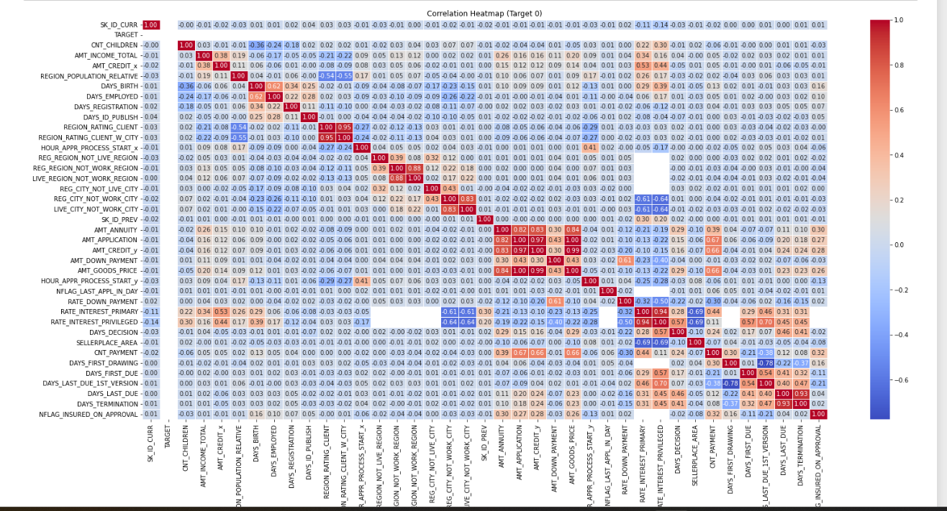
CORRELATION when target 0
Correlation Heat map when target is 0,from this you can easily find the relation between the variables in the dataset.

Slide 26
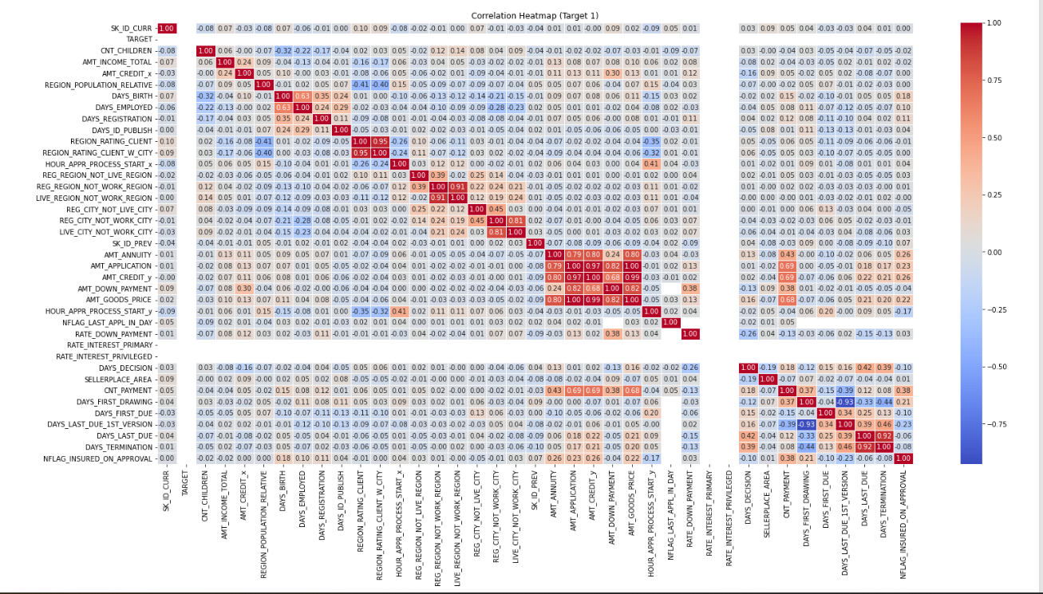
TOP 10 CORRELATION
Correlation Heat map when target is 1,from this you can easily find the relation between the variables in the dataset.

Slide 27
CONCLUSION
In conclusion, the information gleaned from this investigation shed light on a variety of traits and behaviors of loan applicants. The analysis of the total earnings indicated the existence of outliers, or those with much greater incomes than the average. This emphasizes the need of taking income inequality into account when evaluating borrower risk and designing financial solutions to accommodate various income levels. Overall, these insights lead to a more nuanced knowledge of the characteristics of loan applicants, enabling financial institutions to design customized loan products, more accurately assess borrower risk, and offer inclusive financial solutions that meet the varied demands of their clients. Lenders may improve their decision-making processes, encourage responsible lending habits, and assist their clients' financial wellbeing by utilizing these information.

Slide 28
DRIVE LINK
Link for New merged dataset.csv:
https://drive.google.com/file/d/1Of7EgDE4_68AYDJLP_QTNSWBSJcf5-_h/view?usp=drive_link
Link for Python Code Script .ipynb:
https://drive.google.com/file/d/151IvcpsSLFGkBDvLTfUEjr0JhfEtJqns/view?usp=drive_link
Link for Python Code PDF:
https://drive.google.com/file/d/1auttd_NgFr1E4QIJQPAAMxGOYj72lXV5/view?usp=drive_link
Link for clean merged data working file:
https://docs.google.com/spreadsheets/d/1afdiPLT6minpyXCYMlYaV22FNM0jmzYf/edit?usp=drive_link&ouid=113119245928557471712&rtpof=true&sd=true

Slide 29
THANK YOU

